Slide 1
NLP
https://www.youtube.com/watch?v=R-AG4-qZs1A&list=PLeo1K3hjS3uuvuAXhYjV2lMEShq2UYSwX&index=1&t=1s

Slide 2
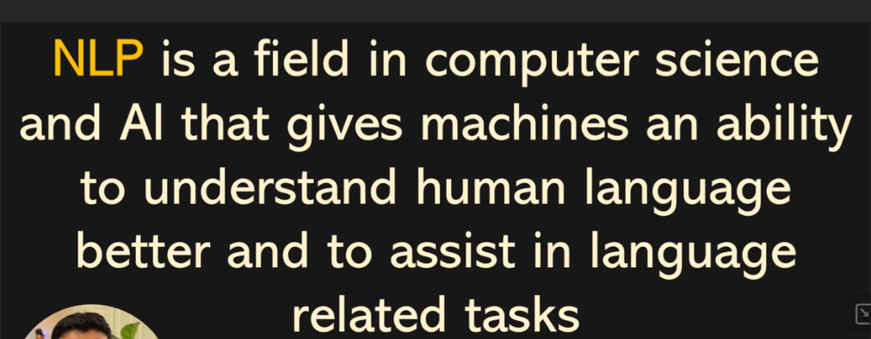

Slide 3
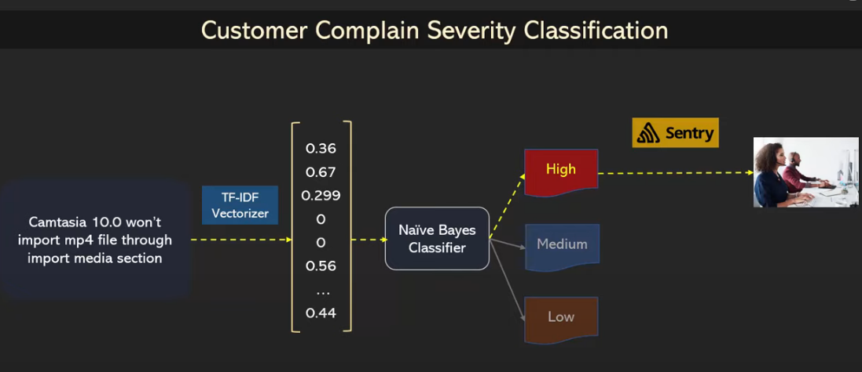
Text Classification

Slide 4
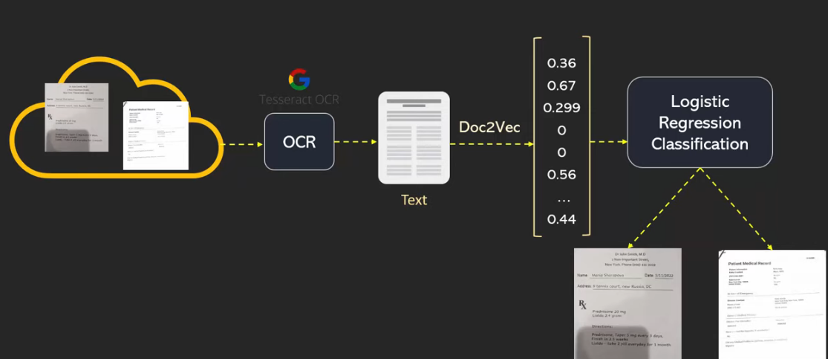
Text Classification

Slide 5
Text Classification
Facebook uses text classification to automatically delete the hate speeches from the portal.
Similarly LinkedIn uses text classification to delete fake profiles.
Spam/Not Spam

Slide 6
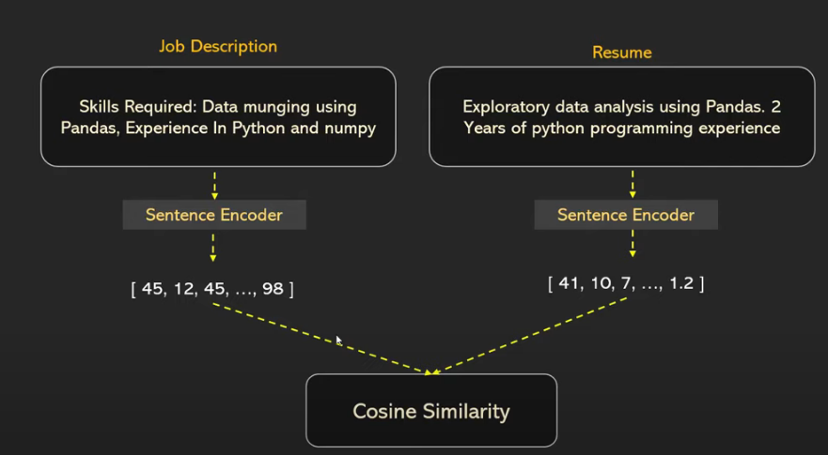
Text Similarity
Matching Resume with the Job Skills (Hugging Face API)

Slide 7
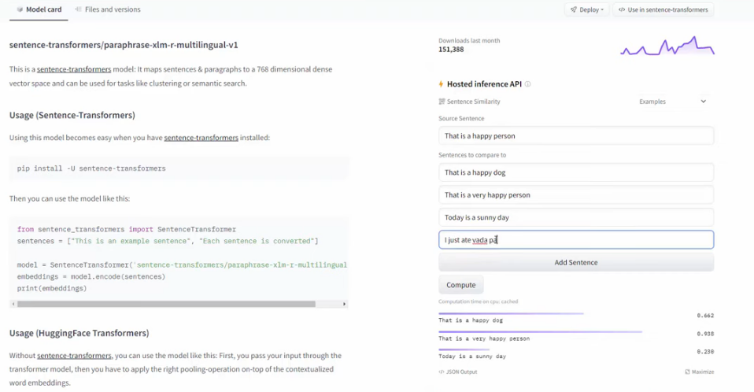
Text Similarity
Matching Resume with the Job Skills (Hugging Face API)

Slide 8
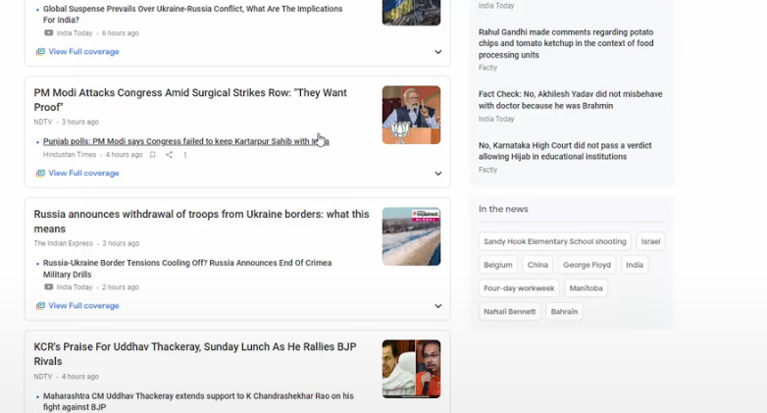
Information Extraction
Fight itenary in email and gmail will derive take off,
Google news shows trending topics are automatically exytacted

Slide 9
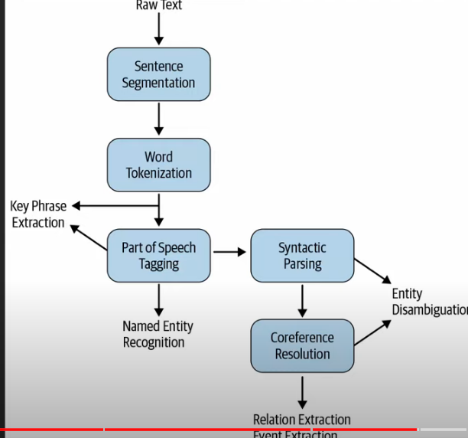
Information Extraction

Slide 10
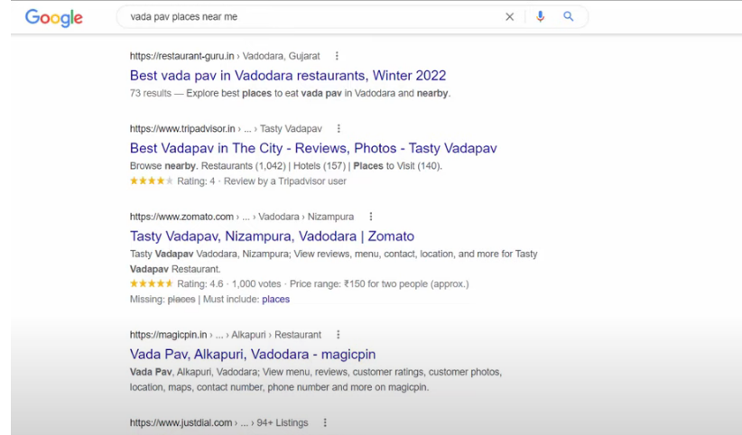
Information Retrieval
Best Example is Google search, return the relevant information in sorted order(TF-IDF, BERT)

Slide 11
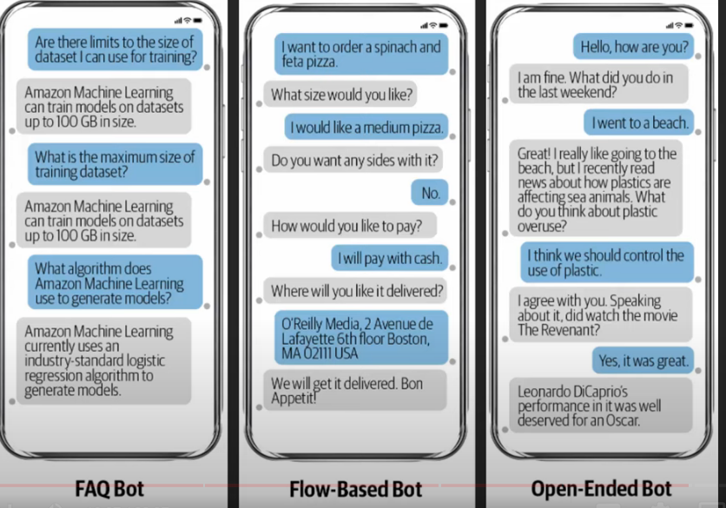
ChatBOT
Simple question and answer with predefined answers
Remembers the previous converstation
Like talking with Friend openended, Siri

Slide 12
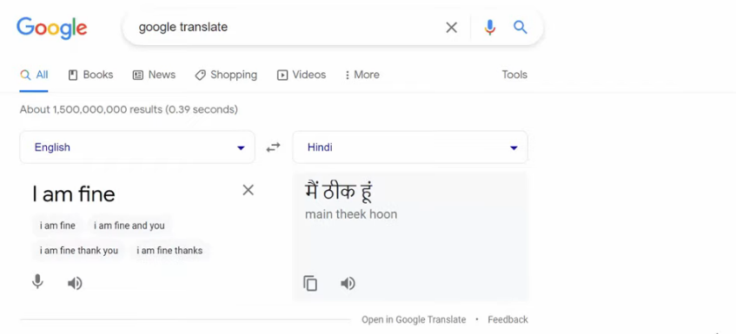
Machine Translation

Slide 13
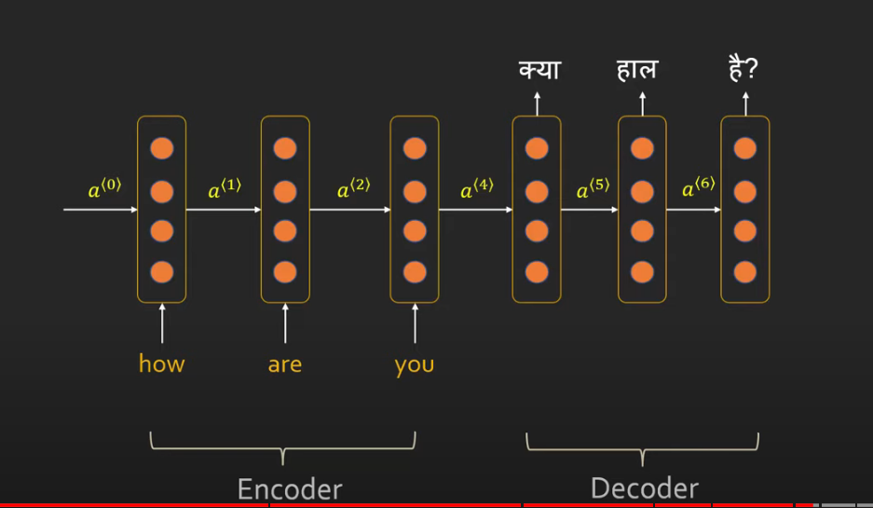
Machine Translation

Slide 14
Language Model
Auto completion in Gmail,
Auto completion in google search
Predicts the probability of next words using some statistical models/neural models

Slide 15
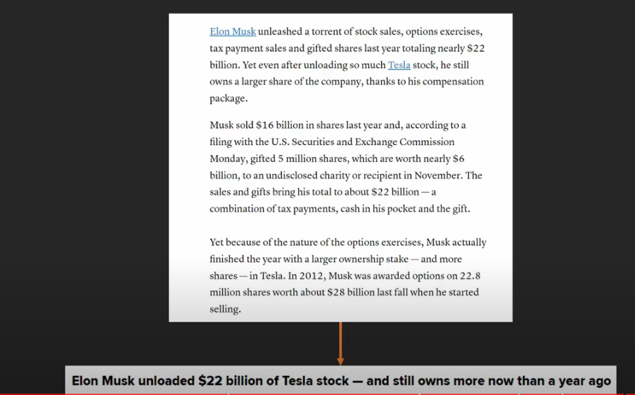
Text Summarization
Coming up with News title

Slide 16
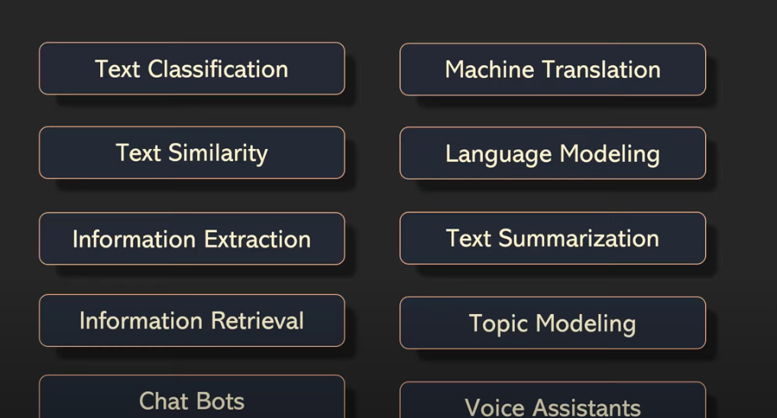

Slide 17
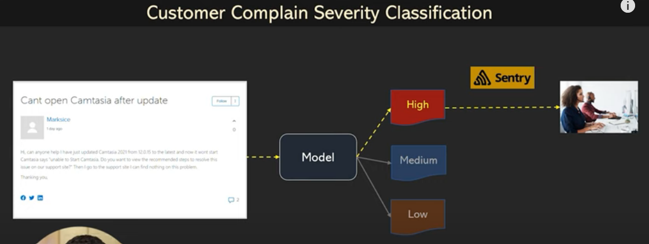
Text Classification
Find High priority topic, Ticket management system

Slide 18
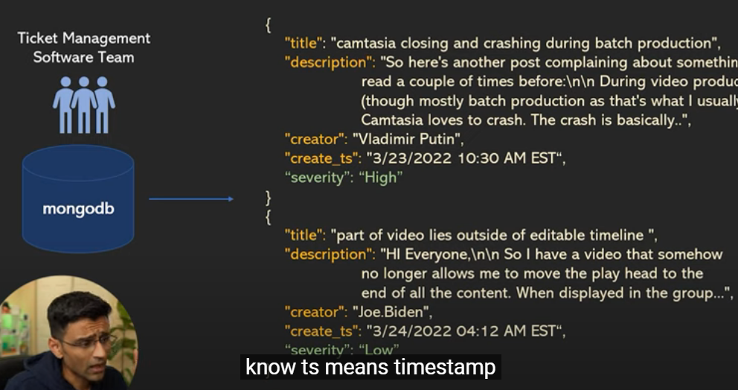

Slide 19
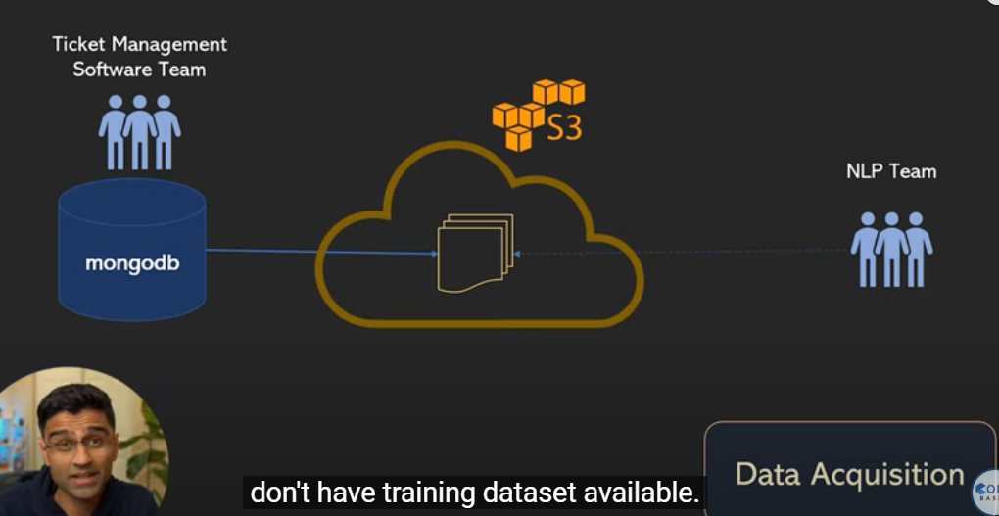
Text Classification

Slide 20
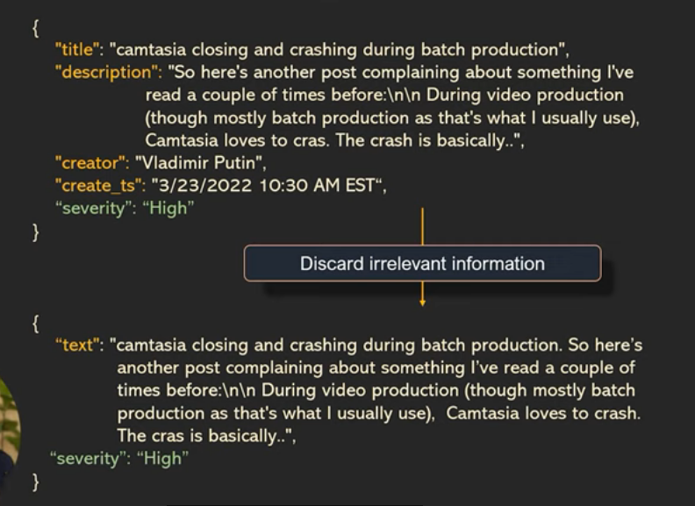

Slide 21
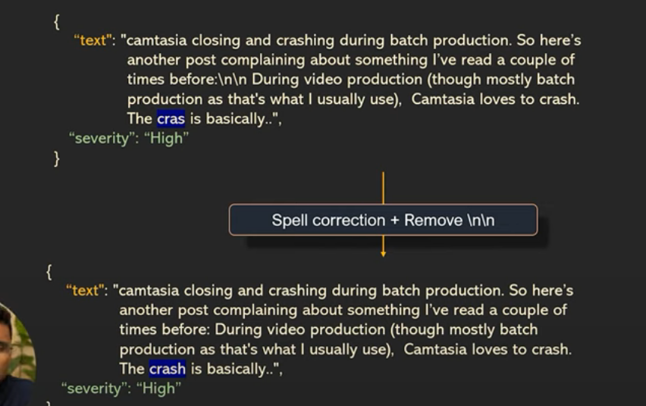

Slide 22
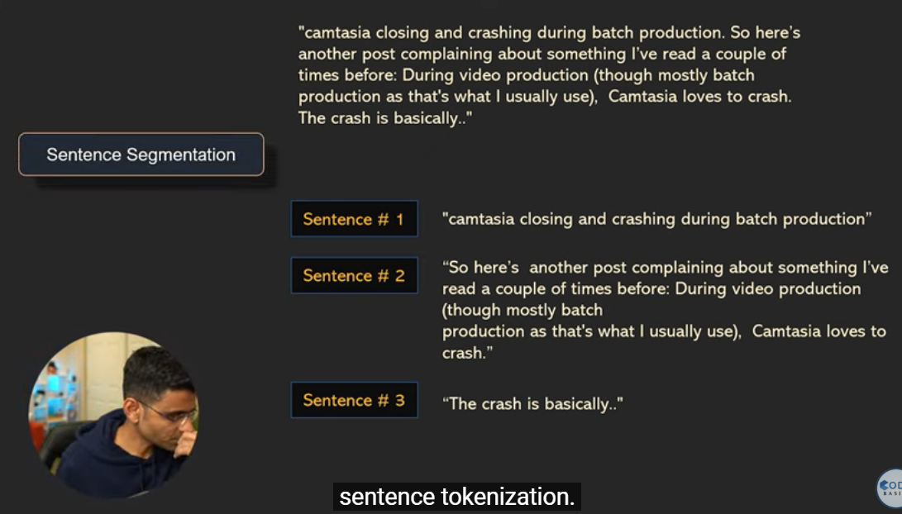

Slide 23
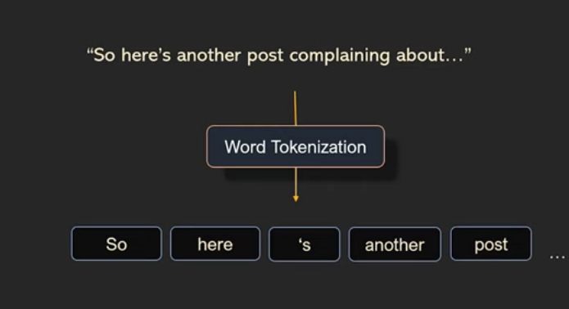

Slide 24
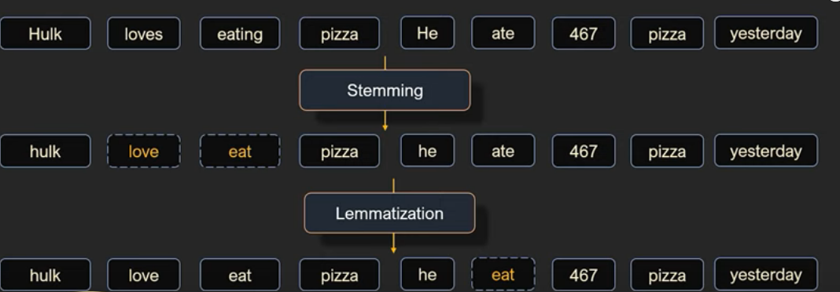

Slide 25
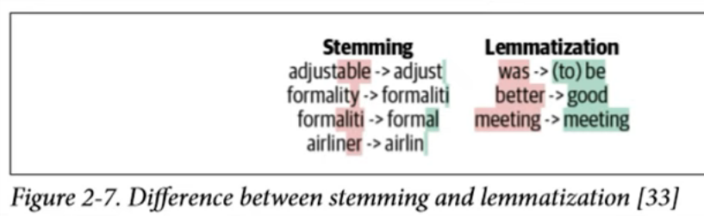

Slide 26
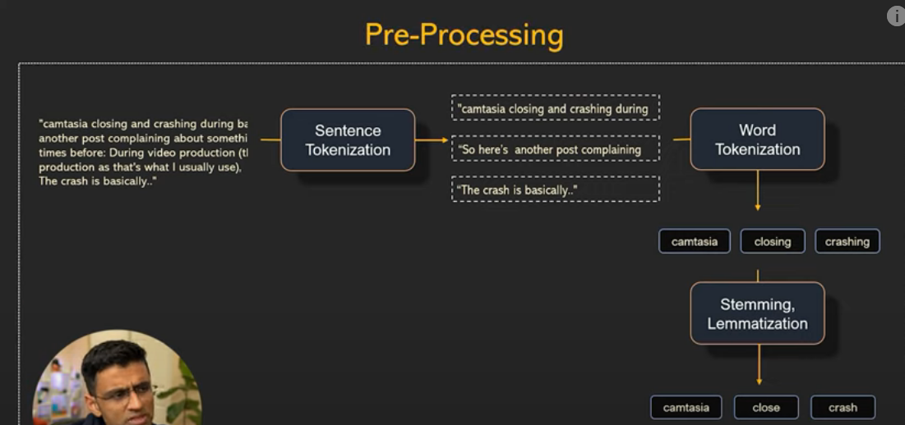

Slide 27
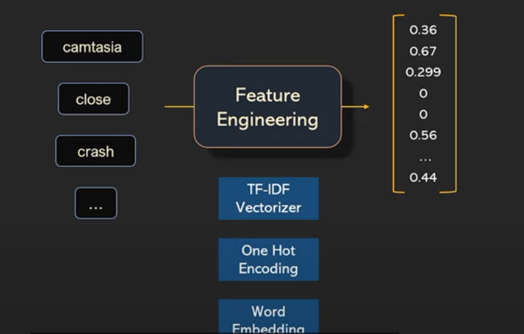

Slide 28
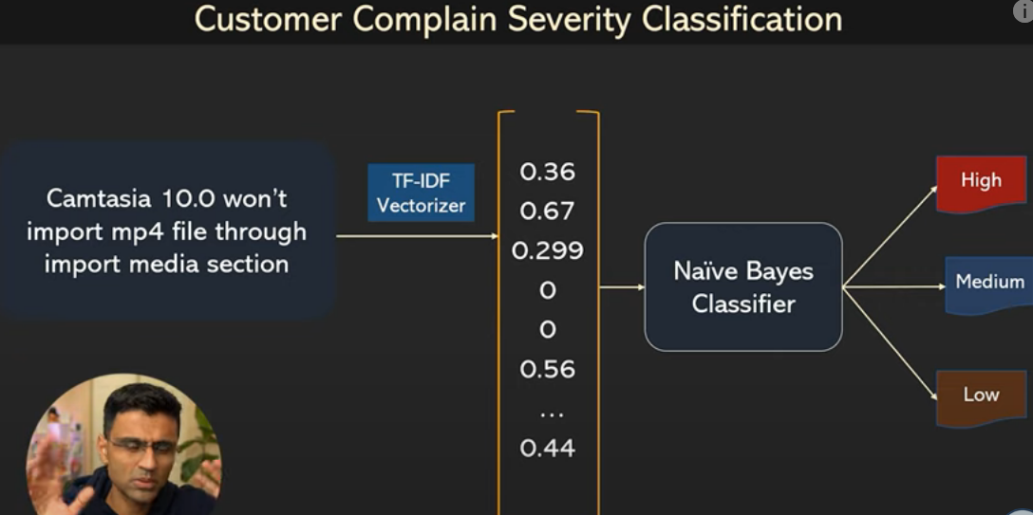

Slide 29
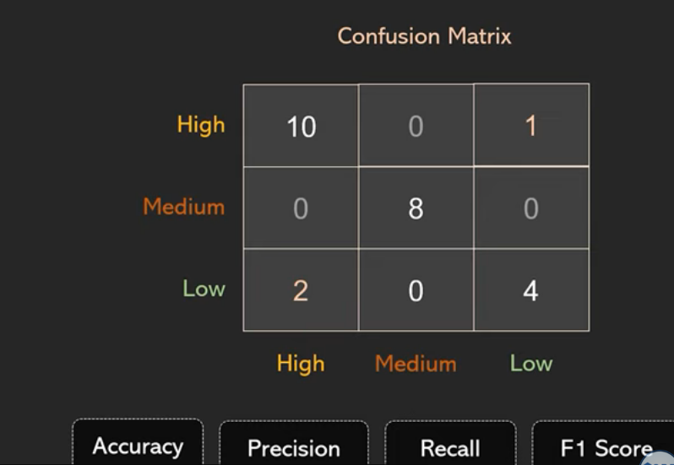

Slide 30
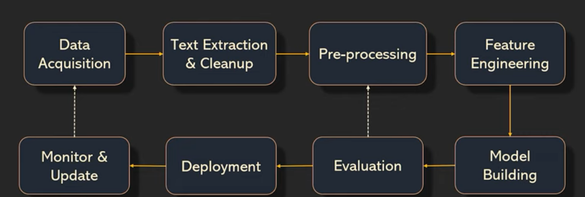

Slide 31
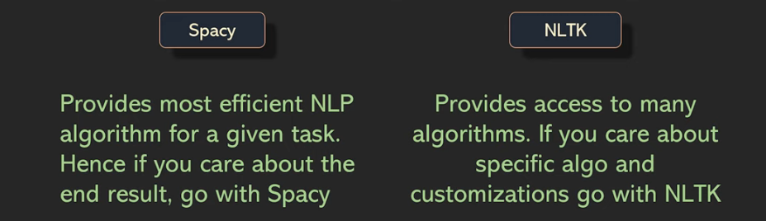
Sentence and Word Tokenanization
Spacy(Object Oriented, new Library, best algo) and NLTK(String Oriented, Old Library, manual DSLR)

Slide 32
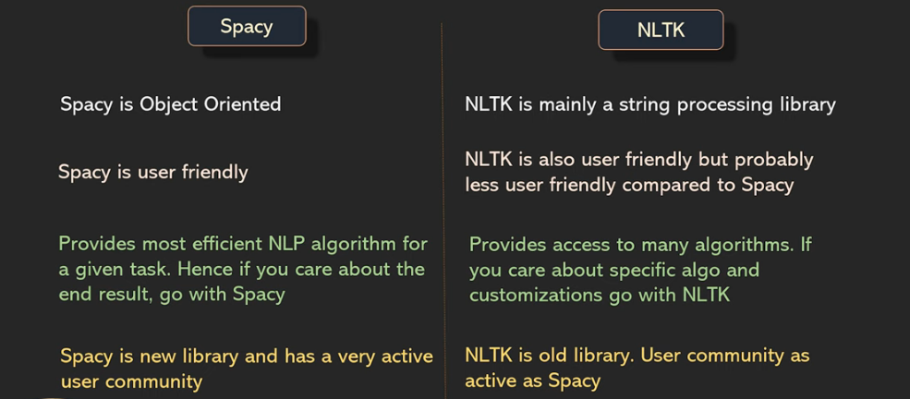

Slide 33
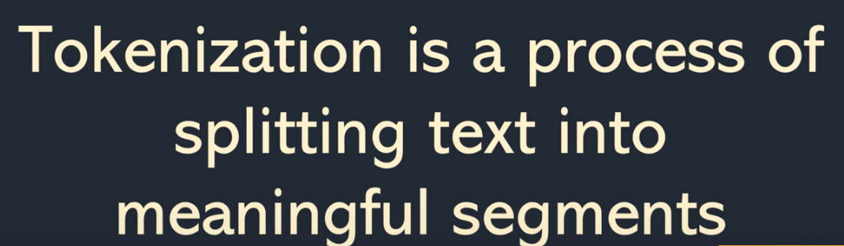

Slide 34
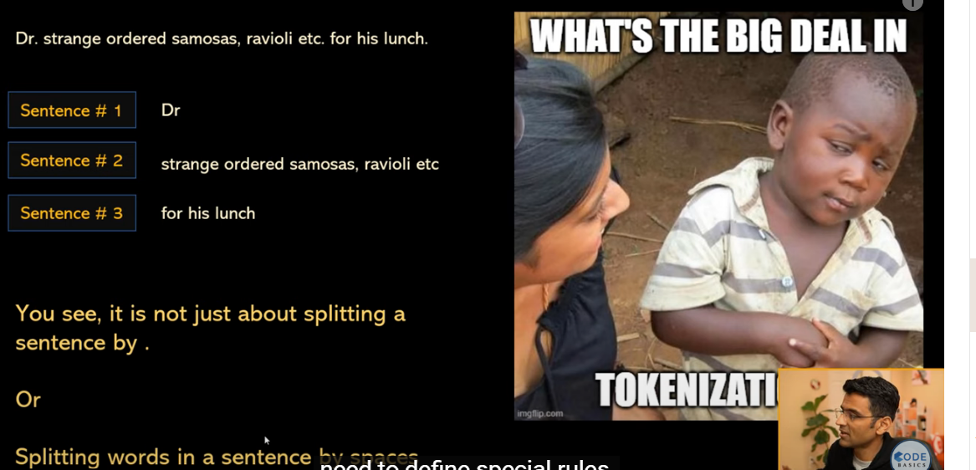

Slide 35
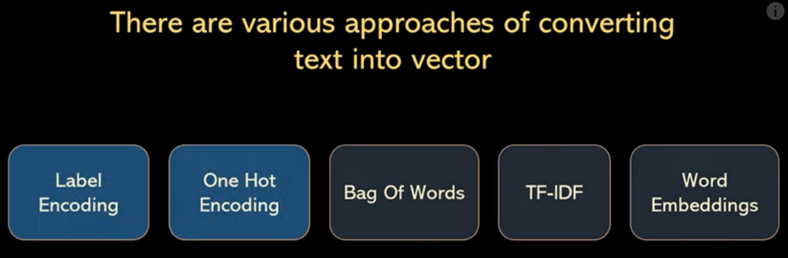
Label Encoding and one Hot Encoding are primitive approaches of feature creation but has many disadvantage
We have set of predefined vocabulary (features)
For any new text(email) to represent word it will consume lot of memory, will not detect similarity and also size of vector will vary for every new text.

Slide 36
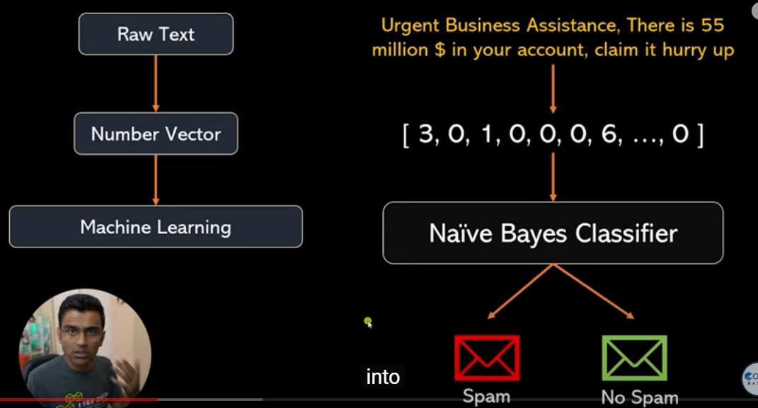

Slide 37
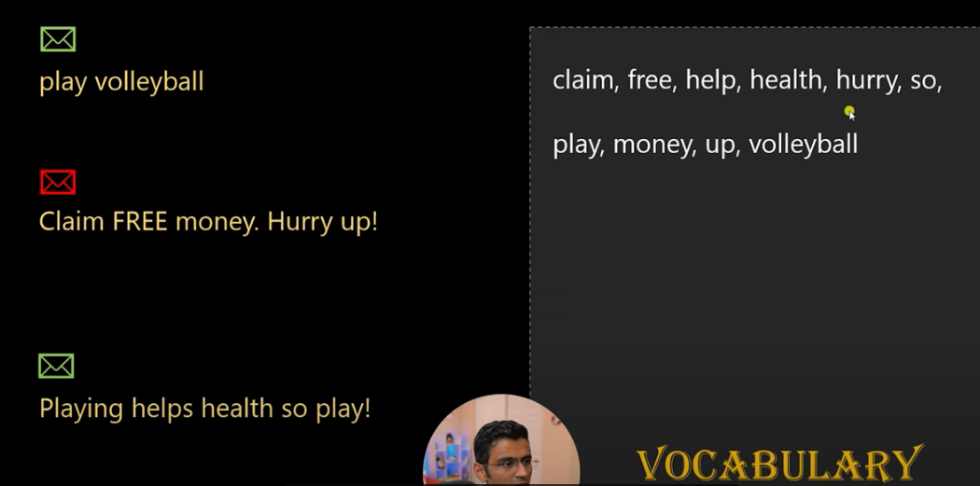

Slide 38
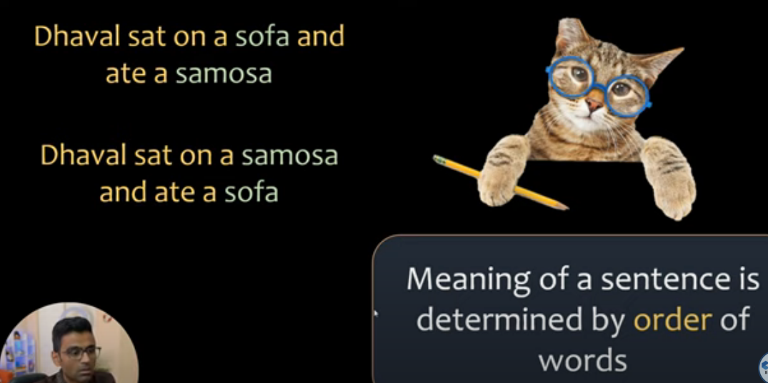

Slide 39
Word embeddings have revolutionized NLP in the last few years. Word2vec, Glove, fastText are a few popular word embedding techniques. New transformer-based word and document embedding techniques such as BERT, GPT, ElMo are further advancing the arena of representing text accurately in form of a dense vector. In this video, we will have an overview of word embedding. There is no coding in this video.

Slide 40
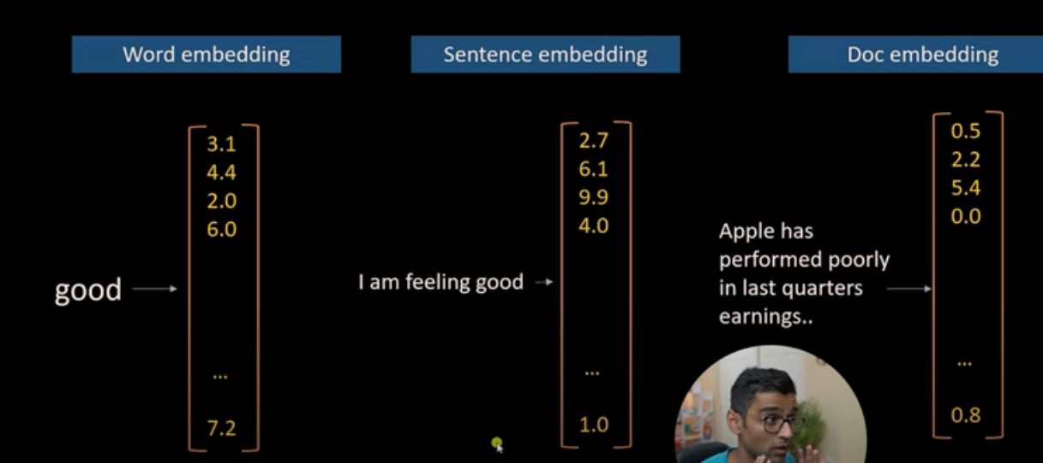

Slide 41
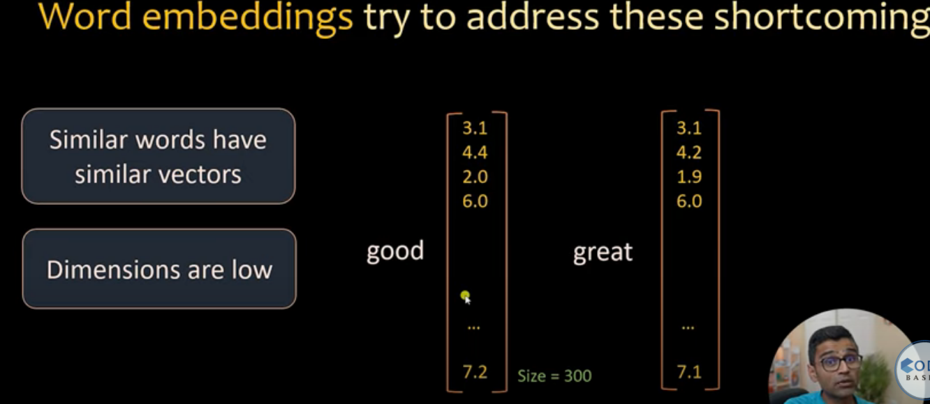
Bag of words and TF-IDF consume lot of memory and space
Cannot capture meaning of words.

Slide 42
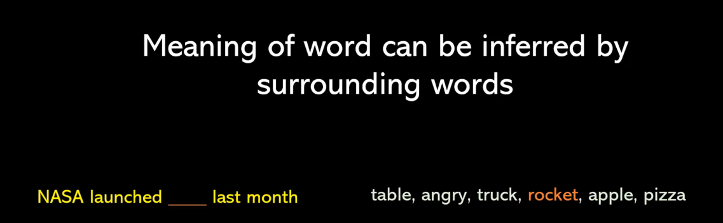

Slide 43
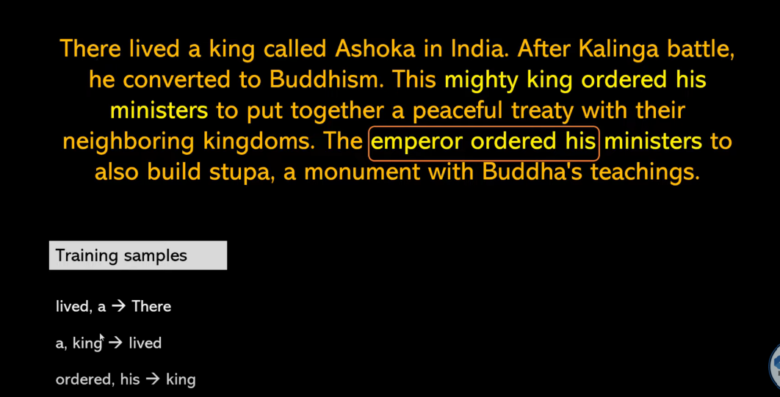

Slide 44
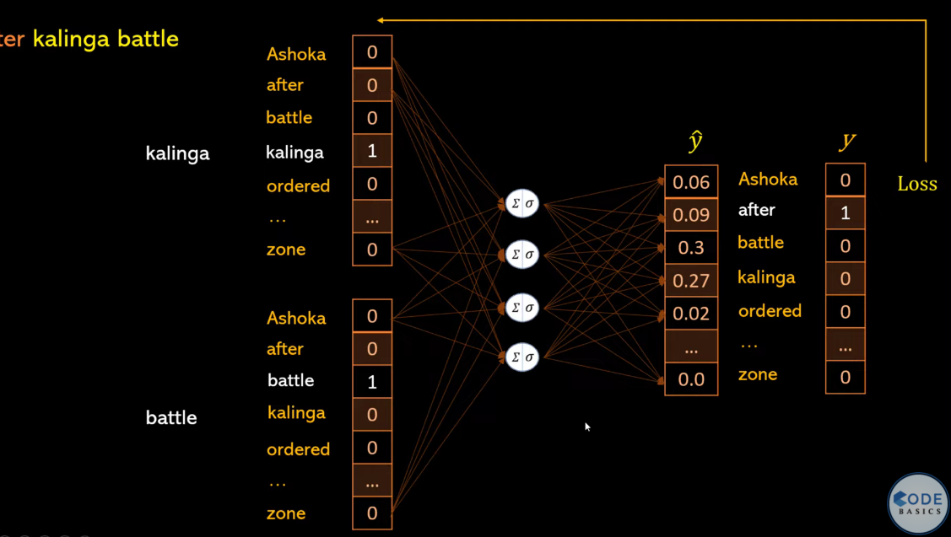

Slide 45
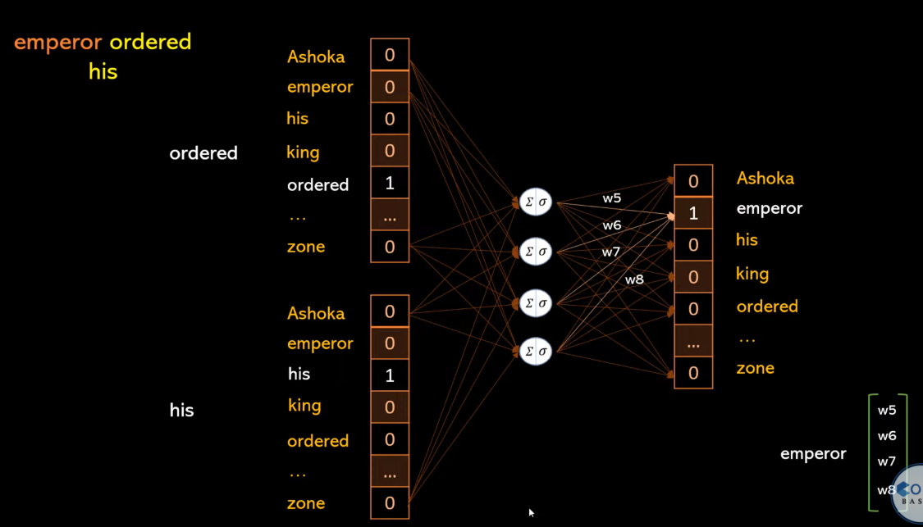

Slide 46
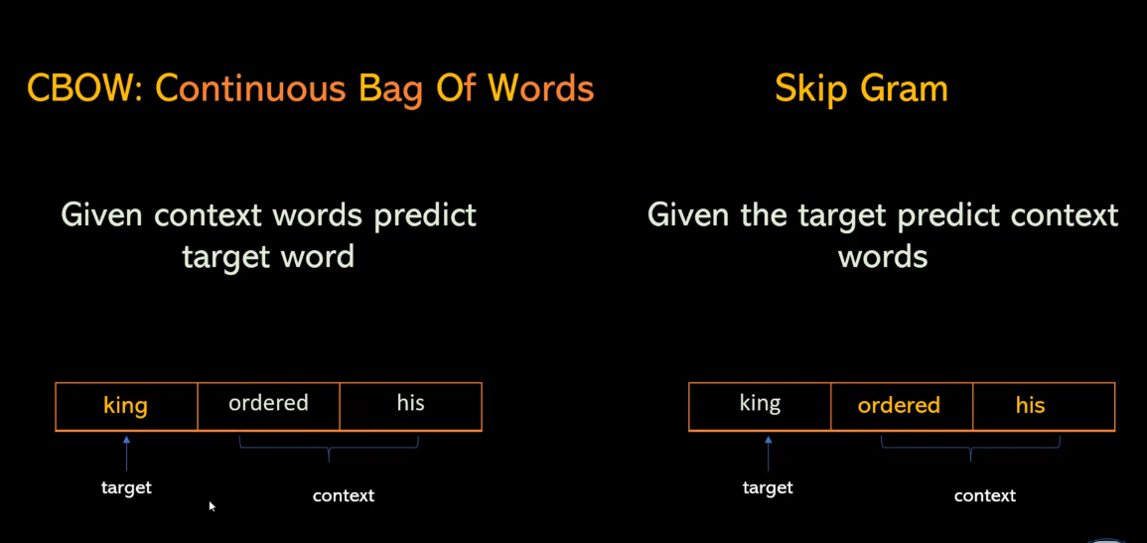

Slide 47
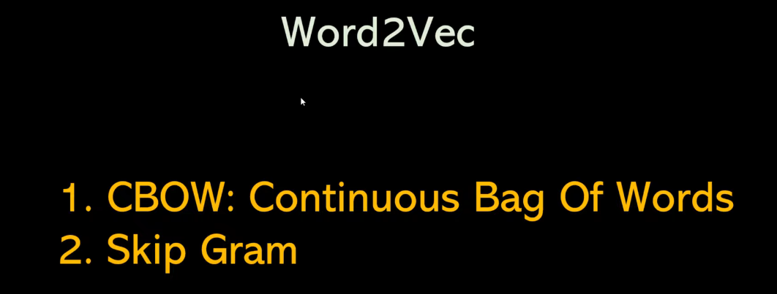

Slide 48
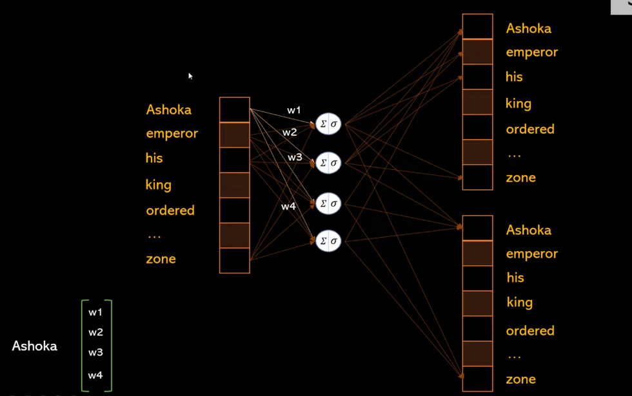

Slide 49
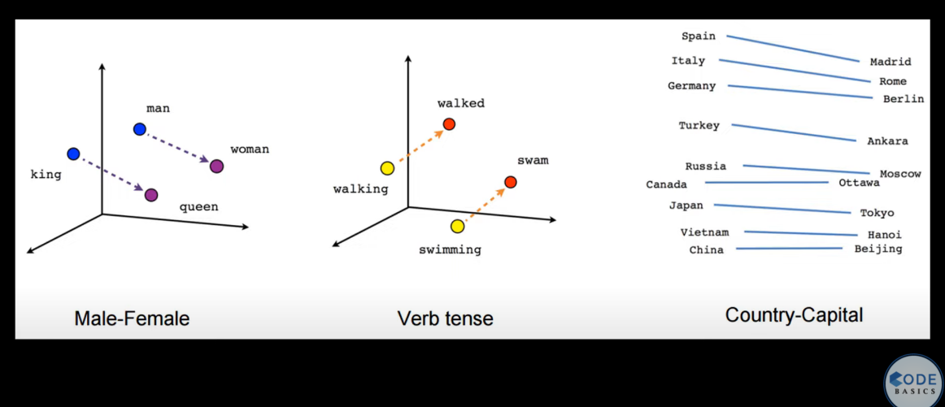

Slide 50
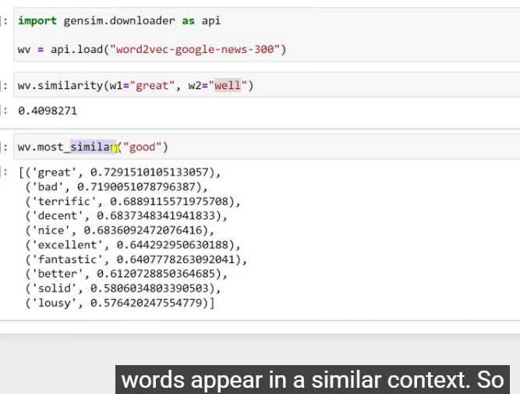

Slide 51
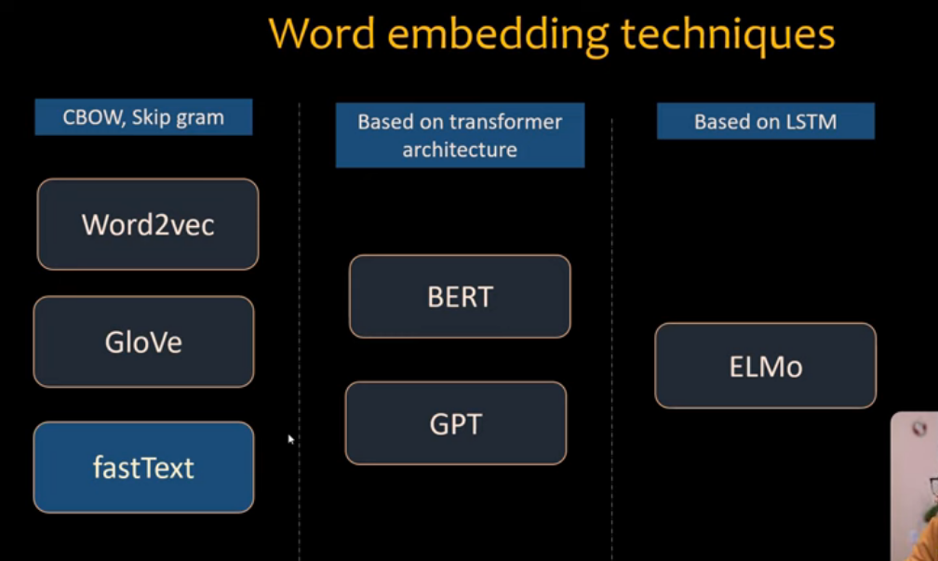

Slide 52
Large Language Model (LLM): "LLM" could refer to a large language model like GPT-3.5, which is capable of generating human-like text based on the input it receives.

Slide 53
"GPT" stands for "Generative Pre-trained Transformer." It is a type of artificial intelligence model designed for natural language understanding and generation. The "Generative" part means it can generate text or content, "Pre-trained" indicates that it is trained on a large dataset before being fine-tuned for specific tasks, and "Transformer" refers to the underlying neural network architecture.
GPT models, like GPT-3, are capable of a wide range of natural language processing tasks, including text generation, text completion, text summarization, language translation, question-answering, and more. These models have been influential in various applications, such as chatbots, language translation services, content generation, and even scientific research.

Slide 54
Word Embedding
Word embedding is a technique used in natural language processing (NLP) and machine learning to represent words as vectors in a continuous vector space.
The primary goal of word embeddings is to capture the semantic relationships and contextual meanings of words based on their usage in large text corpora.
Word embeddings are learned from a large corpus of text, such as a collection of books, articles, or websites. The model analyzes the co-occurrence patterns of words within sentences or documents to adjust the word vectors accordingly.

Slide 55
Word Embedding
Word embeddings are often generated using neural network-based models like Word2Vec, GloVe (Global Vectors for Word Representation), or contextual embeddings like BERT (Bidirectional Encoder Representations from Transformers).
Overall, word embeddings play a pivotal role in making machine learning models understand and work with human language effectively, bridging the gap between the symbolic nature of language and the numerical processing capabilities of machine learning algorithms.

Slide 56
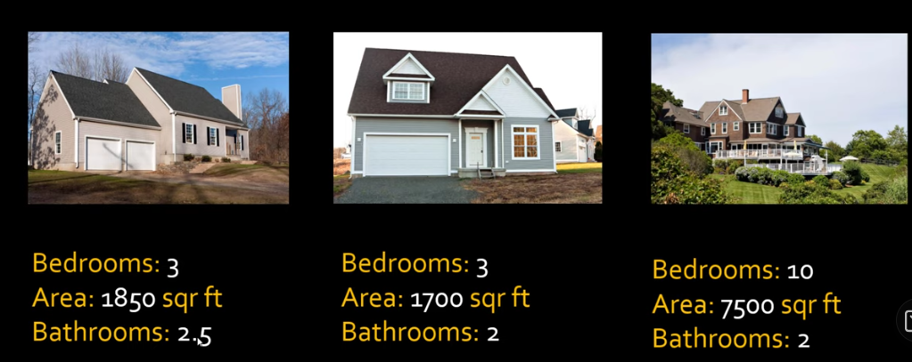

Slide 57
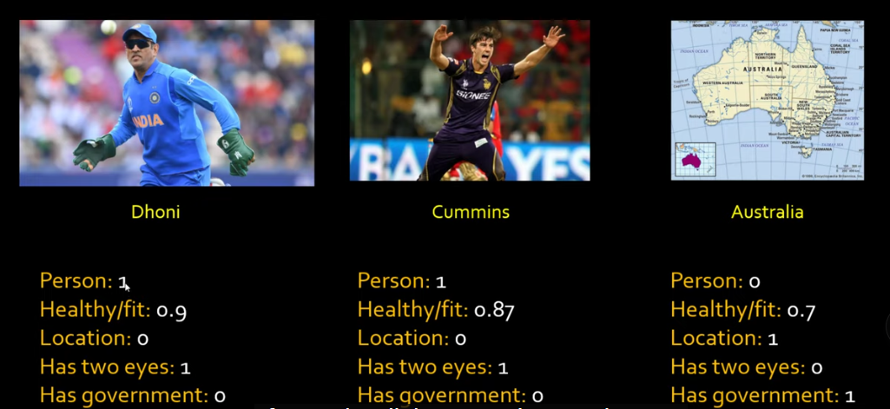

Slide 58
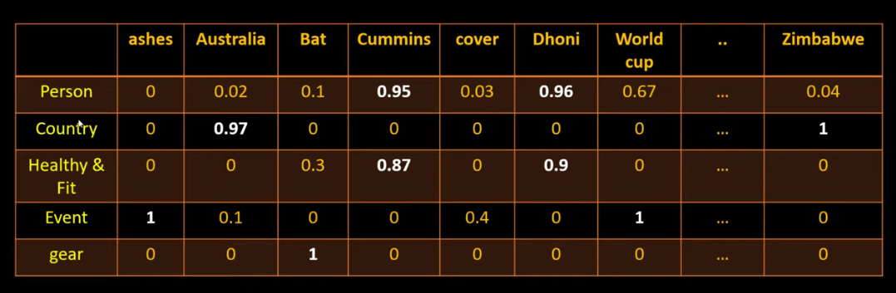

Slide 59

Take a fake problem, Solve it using neural network
You get word embeddings as a side effect
Fake problem : fill in missing word in a sentence

Slide 60
Meaning of the word can be derived from the surrounding words, the surrounding words are called sentence.
Auto complete the missing words using the window of 3 words, 4 words
This type of problem also called self supervised because all you have is paragraph
Using the backprogations weights are adjusted.

Slide 61


Slide 62


Slide 63


Slide 64

This techniques convert word to vectors which allow computer to do lot of mathematics with it

Slide 65


